Slide 1
Delaunay classifier Project explanation
Arnau Dols Férrez

Slide 2


DATA ORIGin
Folder: data
Contains the different datasets in csv format.
{data_name}.csv
Folder: jsons
Contains the parameters to generate/filter each dataset.
data_params.json

Slide 3
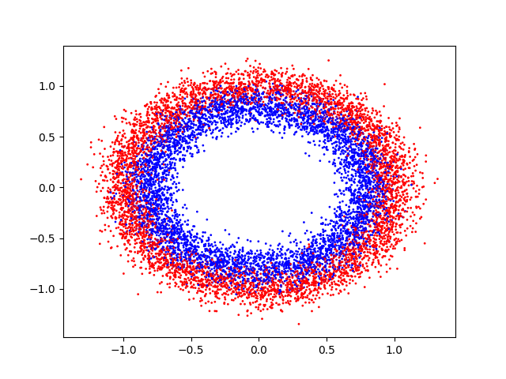
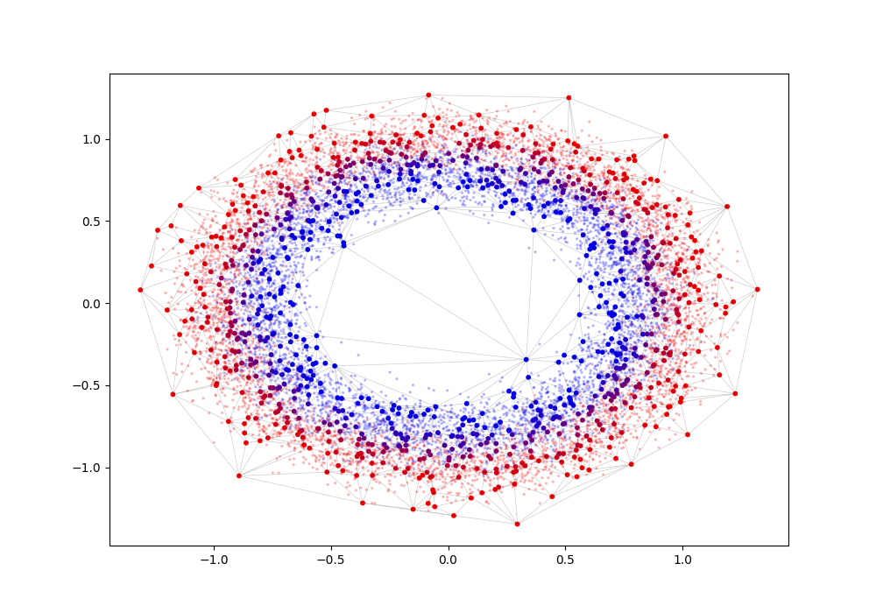
Circles
Data parameters:
n_samples: number of points
noise: noise of data

Slide 4
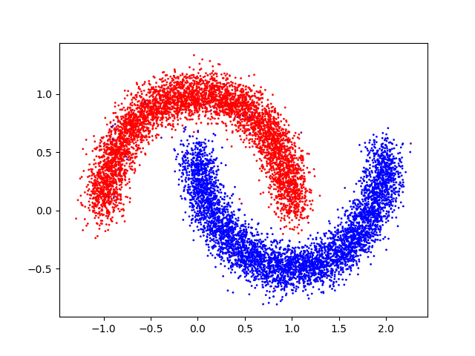
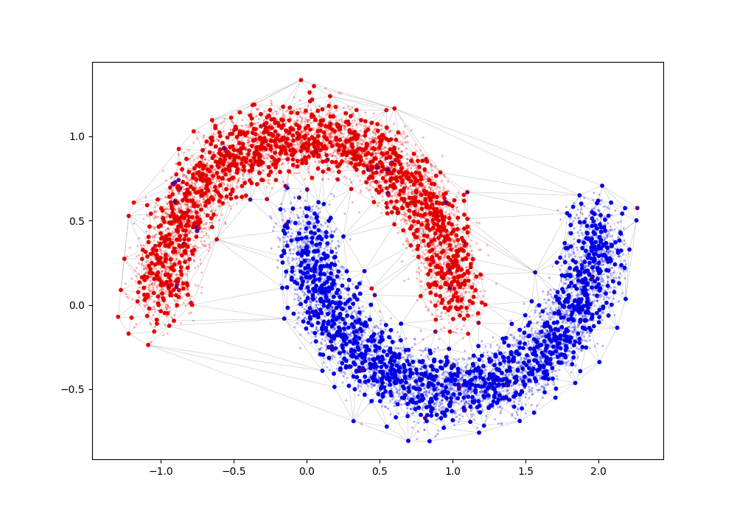
Moons
Data parameters:
n_samples: number of points
noise: noise of data

Slide 5
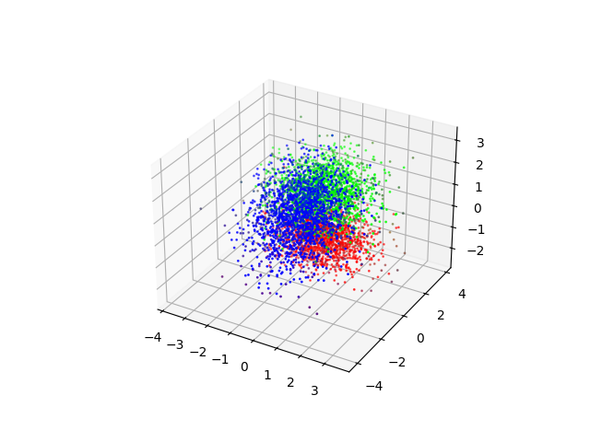
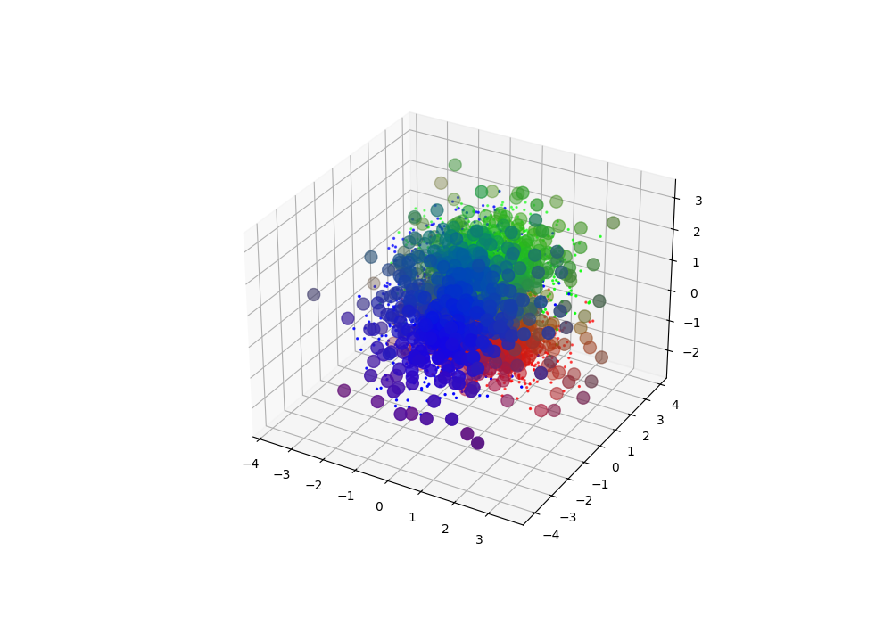
Classification
Data parameters:
n_samples: number of points
n_features: number of features of the data (dimension of data)
n_classes: number of possible labels

Slide 6
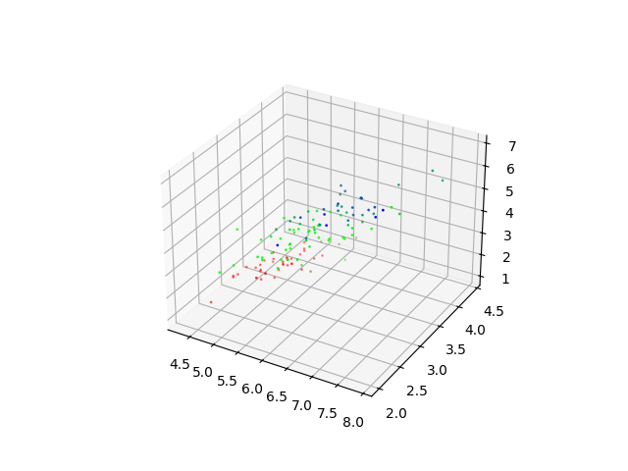
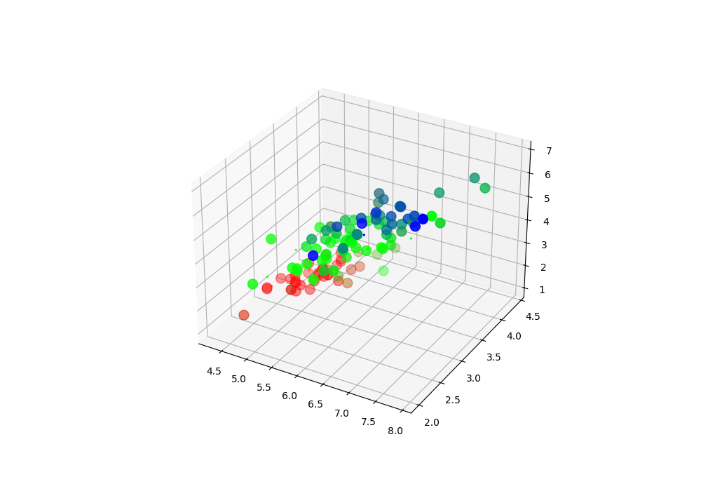
IRIS
Data parameters:
features: features to select from the data
ref_label: if not null, binarizes labels with respect to ref_label label

Slide 7
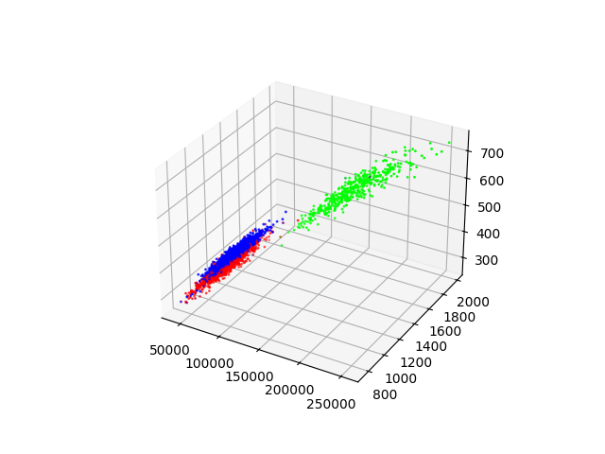
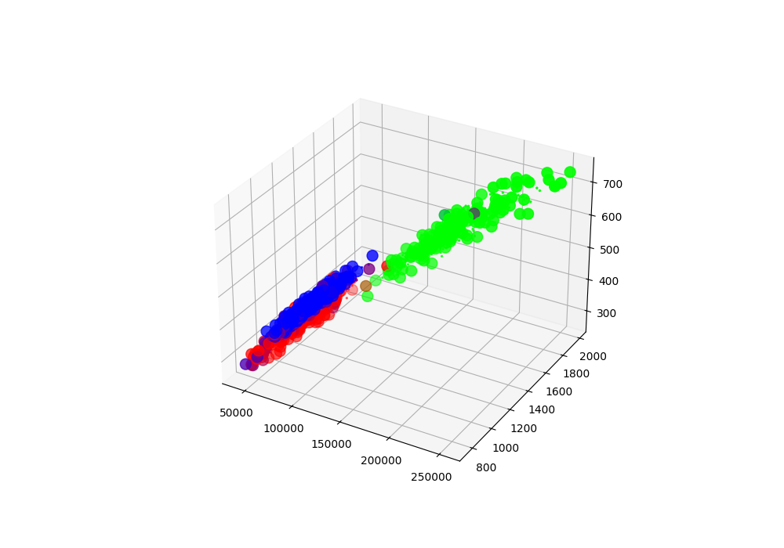
beans
Data parameters:
classes: labels to estimate
features: features to select from the data
ref_label: if not null, binarizes labels with respect to ref_label label

Slide 8
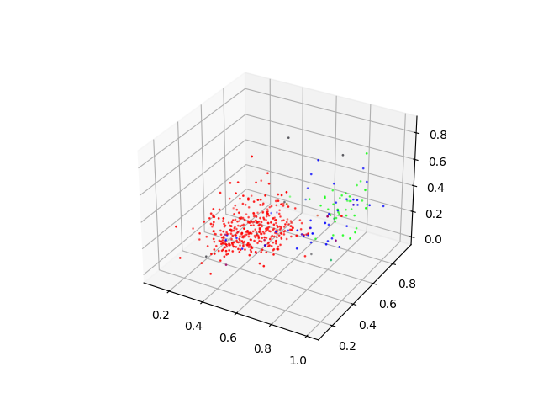
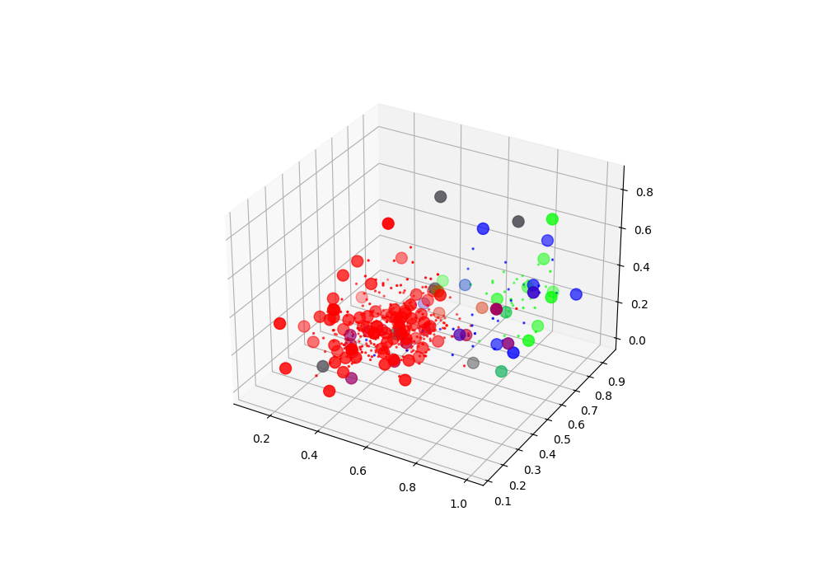
YEAST
Data parameters:
classes: labels to estimate
features: features to select from the data
ref_label: if not null, binarizes labels with respect to ref_label label

Slide 9
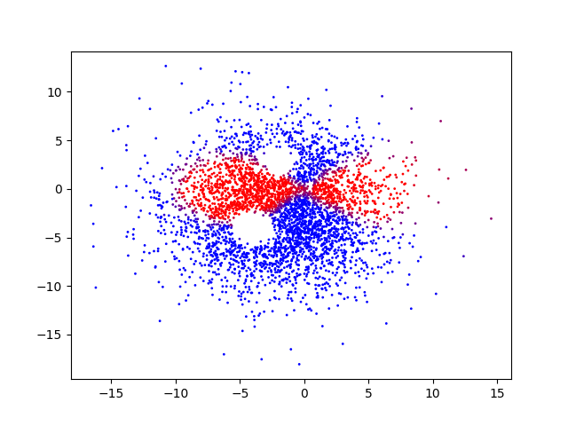
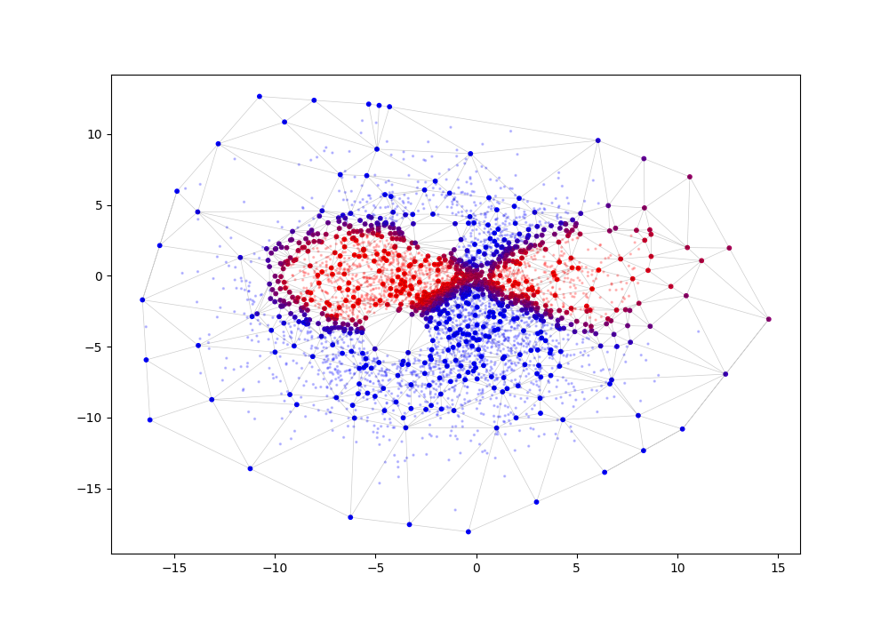
Franco
Data parameters:
dim: dimension of data
n_samples: number of points
n_holes: number of holes in the data

Slide 10
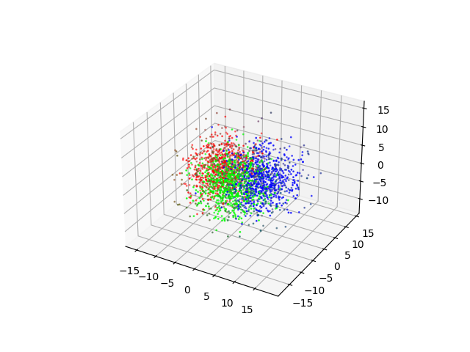
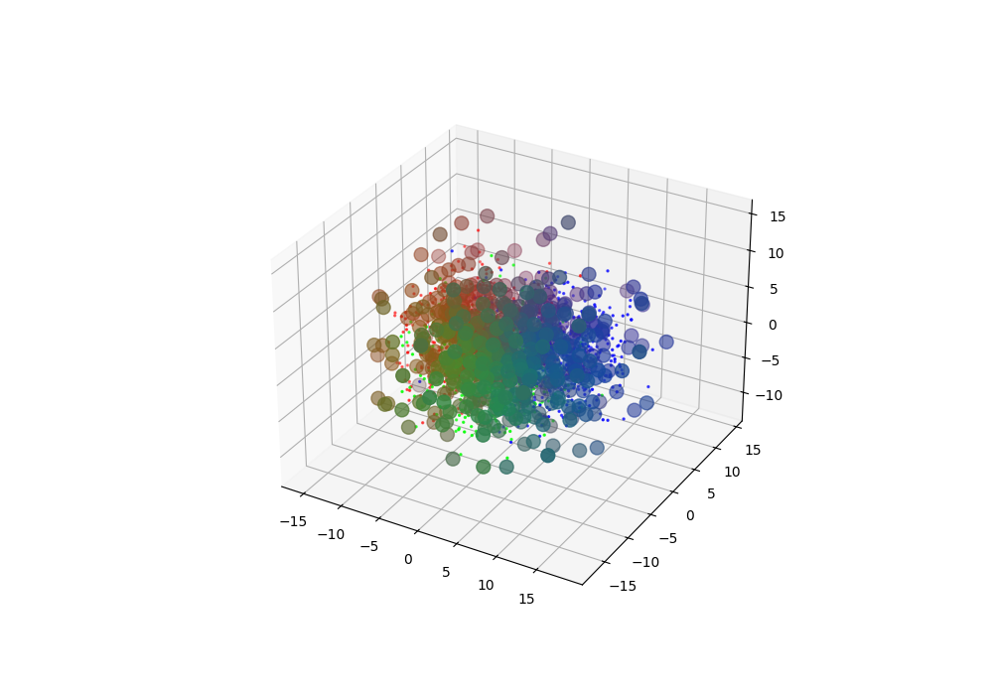
spheres
Data parameters:
dim: dimension of data
n_samples: number of points
n_samples_per_sphere: number of points per sphere

Slide 11
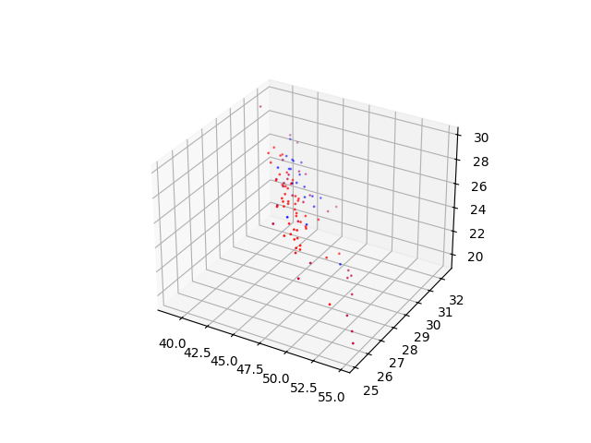
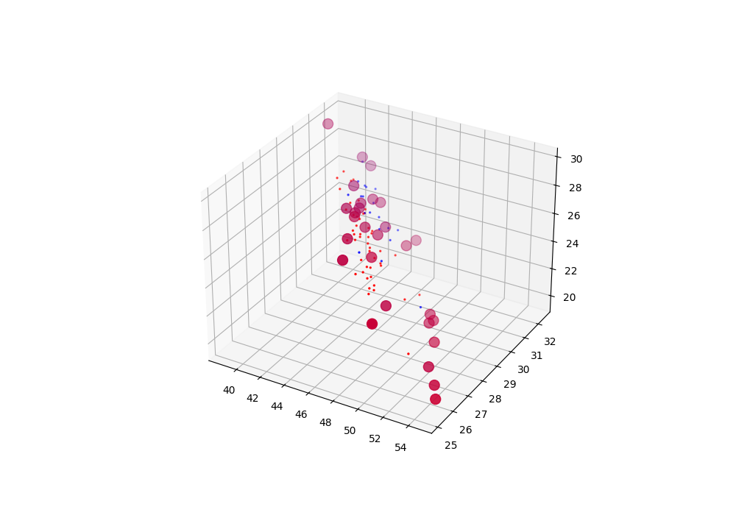
anemia
Data parameters:
features: features to select from the data

Slide 12
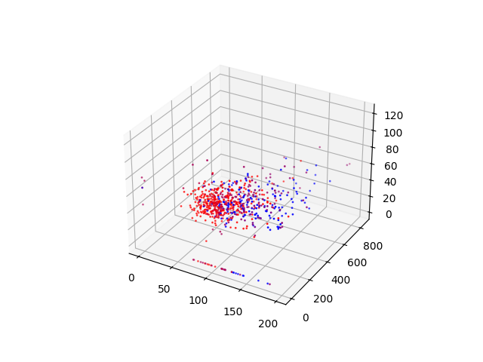
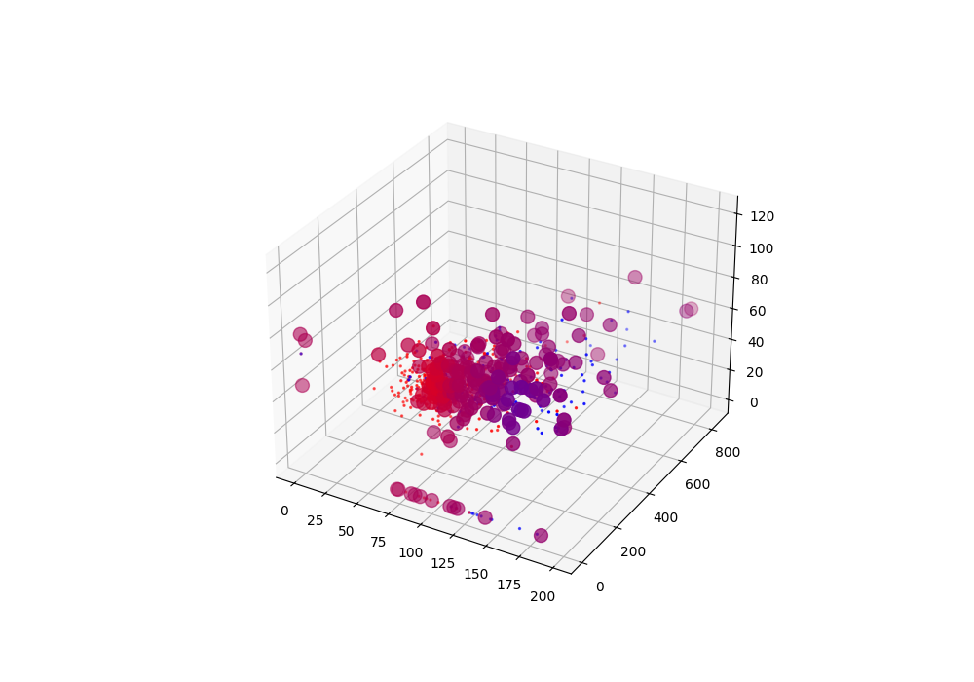
diabetes
Data parameters:
features: features to select from the data

Slide 13
Run params
Folder: jsons
Contains the parameters under which to train each dataset:
size_prop: proportion of the original data used for the Delaunay triangulation.
sampling: type of sampling via which to draw the points for the triangulation (‘random’ or ‘entropic’)
test_size: number of points to use to compute the real error.
al: measures the magnitude of the overall displacement
errw: weight of the error gradient (between 0 and 1)
avw: weight of the averages balance equations
rep: number of times the convex hull is refined
bc_time: time at which to add barycenters.
mte_threshold: threshold above which the barycenters will be added.
seed: random seed from which to generate the triangulation points.
run_params.json

Slide 14
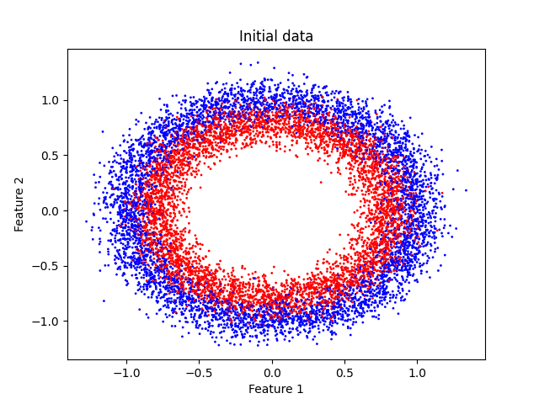
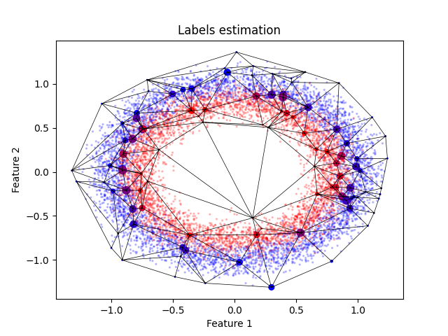
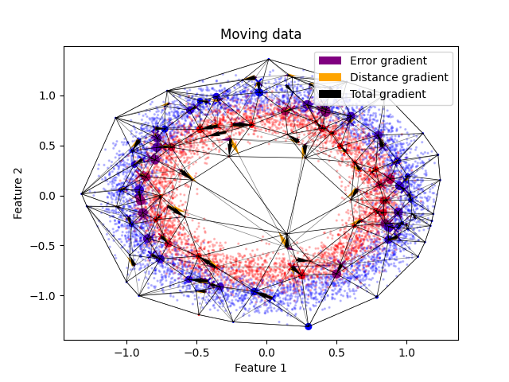
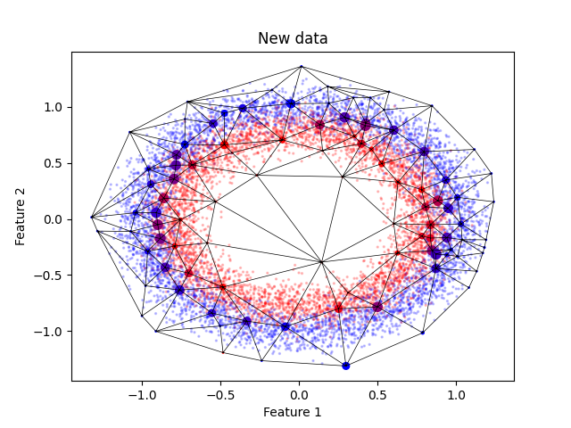
MOVING POINTS

Slide 15
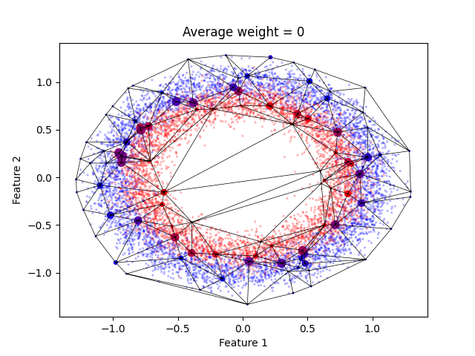
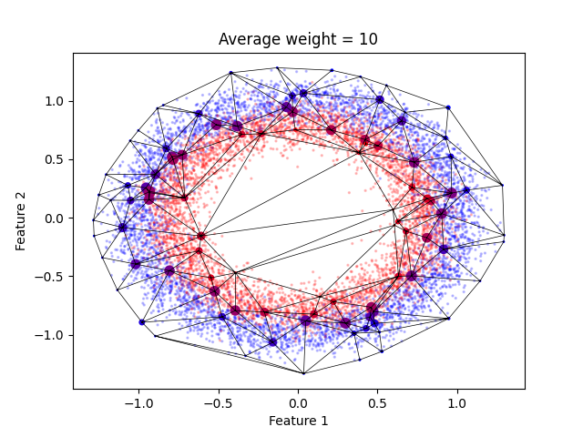
AVERAGES BALANCE

Slide 16
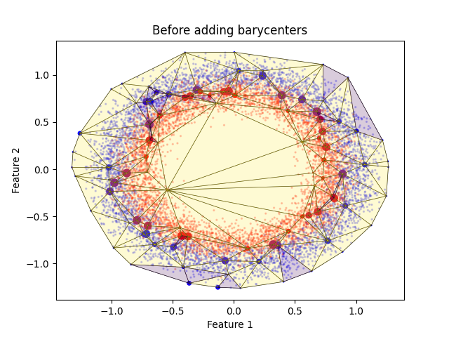
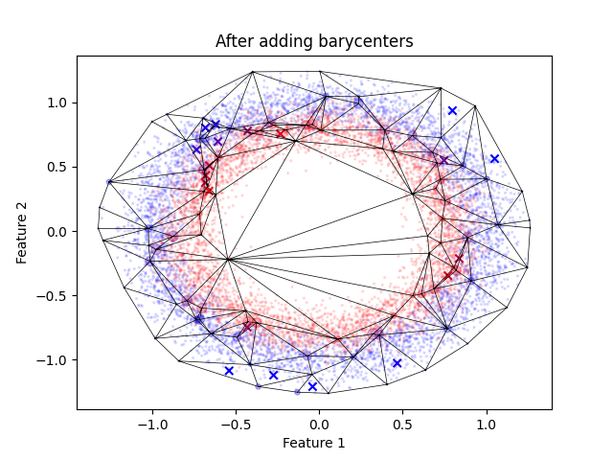
Adding barycenters

Slide 17
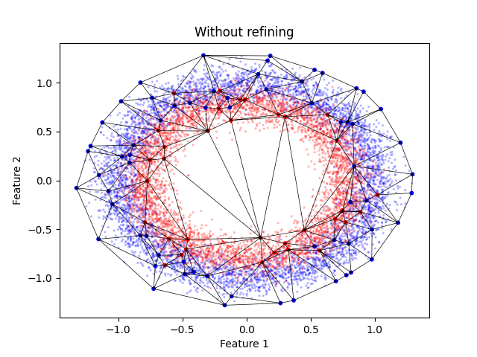
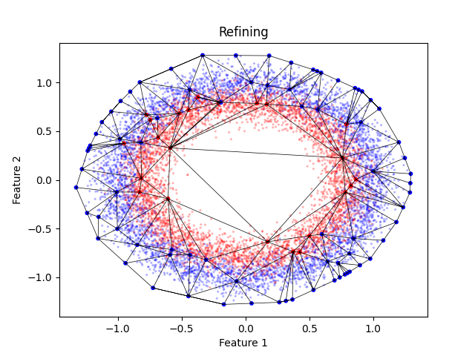
Refining convex hull

Slide 18
CLASSIFIERS FOLDER
This folder includes:
All the classifiers trained, in folders.
general_metadata.json: saves the data and training parameters in one json. In case the name of a trained classifier is unknown or forgotten, one can query part of those parameters and the program will try to find it.

Slide 19
CLASSIFIER structure
classifier.csv
metadata.json
metrics.csv
For each point of the data used (triangulation points + training data):
x_i (default): the values of the features
y_i (default): The values of the reshaped labels (if m labels, m-1 columns with values between 0 and 1)
sample: if the point belongs to the triangulation
out_hull: if the point belongs out of the boundary of the convex hull
name of the dataset
data_params used in the data extraction.
run_params used in the training.
For each iteration:
training_error: mean training error
error_variance: variance of the training error
edge_variance: variance of the size of the edges of the triangulation.
real_error: mean real error of the test data.

Slide 20
functions
class_functions.py: functions to perform a full training of an initialized classifier. This includes estimating labels, moving points and adding barycenters in multiple iterations.
classification_functions.py: functions to classify new data given a classifier.
initialization_functions.py: functions to initialize a classifier to be trained.
measuring_functions.py: functions to measure the metrics of the training of a classifier. This includes mean training error, error variance, edge size variance and real error.
plotting_functions.py: functions to plot the data of a classifier and the metrics of its training.
reading_functions.py: functions to read datasets and their parameters.
training_functions.py: functions to train a classifier one step at a time. This includes estimating labels, adding barycenters and moving points.

Slide 21
CLASSES
Classifier.py:
Classifier: initializes a classifier (reads data, triangulates, estimates labels) to be trained. If given new data, it classifies it. Intended to be adapted for any new incoming dataset.
TestClassifier: initializes a Classifier instance given one of the studied datasets.
Measurer.py: measures the metrics of a Classifier during its training.
Trainer.py: trains a Classifier.
Reader.py: recovers a previously trained Classifier.
Writer.py: writes Classifier and Measurer data in a folder.

Slide 22
MAIN FUNCTIONS
delaunay.ipy: given a dataset name, extracts the dataset, the data parameters and the training parameters and initializes, trains and writes a new classifier.
pretraining.ipy: given a dataset name, extracts the dataset and the data parameters and trains different classifiers without moving the points or adding barycenters. The objective is to determine the better:
size_prop, spanned in [0.05, 0.1, 0.15, …, 0.5].
avw, spanned in [1,1.5,2,…,10].
sampling, either random or entropic.
The original data is divided in classification (triangulation points) data, training data, test data and validation data, the latter being isolated form the whole process. All the results are saved, and the parameters that have yielded the smaller error estimating the labels of the test data are labeled as ‘optimal’. Finally, we apply the optimal parameters and classify the validation data, compute the error and save the results.
pipeline.ipy: given a dataset name, extracts the dataset and the data parameters and trains different classifiers with predetermined training parameters:
balanced_gradient: errw = 0.5
error_gradient: errw = 0.9
distance_gradient: errw = 0.1
Each of these are also subdivided in:
Simple: no barycenters, no refining the convex hull.
Barycenters: adds barycenters.
Refine: refines convex hull.
Full: adds barycenters and refines convex hull.
The parameters are found in trainers_params.json in jsons.
reading.py: given a trained classifier name, reads it and plots the data and the metrics.

Slide 23
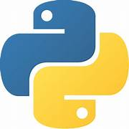
dependencies
initialization_functions.py
classification_functions.py
reading_functions.py
Reader.py
Classifier.py
measuring_functions.py
training_functions.py
Measurer.py
Trainer.py
plotting_functions.py
Writer.py
class_functions.py

Slide 24
REMARKS
The method works well with all the synthetic datasets: circles, moons, classification, franco and spheres.
The method performs worse with:
Datasets with little points: Iris
Datasets with a very specific structure, possibly embedded in manifold: Beans.
Datasets with already very unclear structure (data with different labels very mixed).
Refining the convex hull, adding barycenters and using entropic sampling improves in general the training. For the other parameters, using pretraining.ipy and pipeline.ipy is advised to determine the best parameters.

